Slide 1
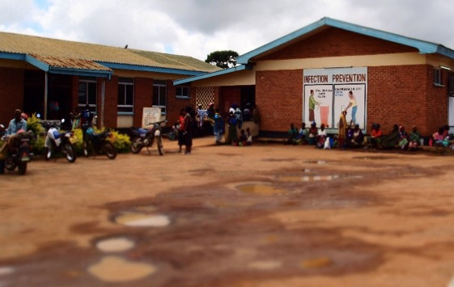

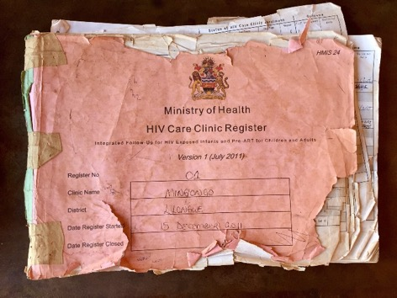
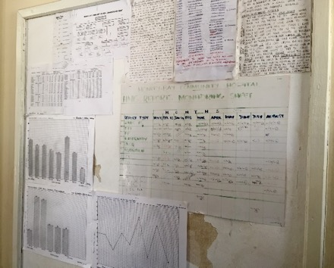
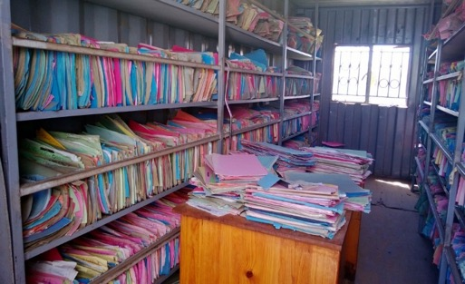
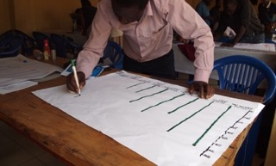



Andrea Fletcher
Lead Data Strategist
Cooper/Smith
andrea@coopersmith.org
DIAL-Malawi Use Case

Slide 2






Project Objectives
How can we use better data to improve the availability of health services to underserved populations?
Problem Statement
Malawi is experiencing rapid population growth and urbanization
Large segments of the population lack access to primary health care facilities
Flood and Drought displace populations, shifting burden of care
Proposed Approach
Develop a dynamic model using previous untapped cell phone data - helping Malawi’s Ministry of Health (MoH) track population growth & migration
Triangulate mobile network (MNO) data with population density and disease burden
Spur iterative decision-making, better data use in routine budget execution & program planning
Notes:
As we move forward, our goal is to generate population level insights that can inform policy.
MOH- Ministry of Health
MNO- Mobile Network Operator
Problem Statement
A population experiencing rapid growth, largely due to increases in life expectancy and the eighth highest fertility rate in the world (an average of 5 children per woman)
Increased urbanization, projected to rise by 4.2% annually between 2013 and 2030
The lowest nominal GDP in world (255 USD per capita in 2014), and over 70% of residents living below poverty line
Poor health services quality with limited and unequal access
Vulnerability to multiple shocks, including Floods, Drought and epidemic disease
Proposed DIAL Approach
Triangulate MNO data (pop density, footfalls, gatherings), UNICEF population & GIS data, with disease burden
Develop a dynamic model that helps MOH inform allocation of resources in terms of budget execution and program planning
Decision support: better data use in routine budget execution & program planning.

Slide 3
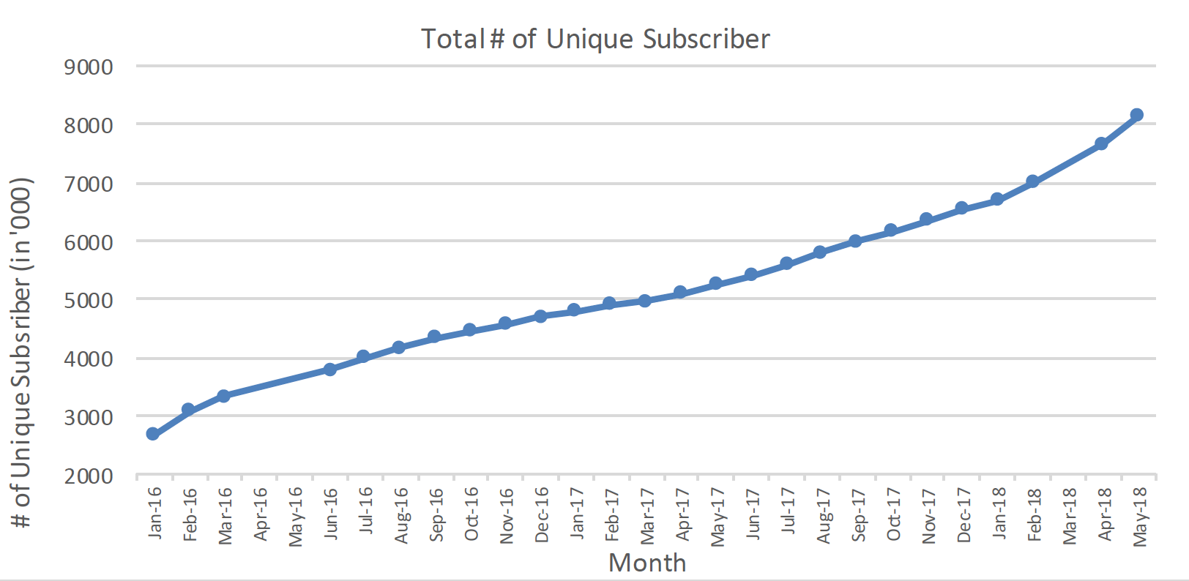
Malawi Mobile Phone Users
Rapidly increasing number of subscribers in Malawi suggests significant mobile phone penetration
Notes:
In Malawi, rapid rate of mobile penetration as evidence by increase in unique mobile subscribers offers an opportunity to better understand population dynamics

Slide 4
Summary of Findings from Analytical Exercise
An estimated 7.73 million Malawians, or 44.7%, live more than 5 km walking distance from a clinic or health post
With no new health facilities, 9.7 million will be uncovered by 2023
Malawians migrate from the central region to the south during the rainy season, shifting the burden of care
If floods render roads inaccessible, some facilities will be overwhelmed
Optimized Allocation of 900 Health Facilities will ensure that 95% of Malawians have easy access to a health facility by 2023
Model incorporates population movement, disease burden and Disability Adjust Life Years
Notes:
The presentation will outline the process and explain these findings in detail

Slide 5
Process
October 2017 Finalized MOH 1st Use Case
October 2017 – June 2018 IRB, MACRA, MOH regulatory approvals
July 2018 Analytical Plan development
July-October 2018 MNO Data Extraction & Cleaning
October 2018 -January 2019 Analysis
February 2019 Dissemination to Ministry of Health
March 2019 Launch Dashboard and release White-Paper
Notes:
Lessons learned: process of acquiring the data and ensuring its transfer and storage adhered to best-practices in terms of security and confidentiality required a significant legal and logistical effort

Slide 6
Analytical Products
Step 1: Gap in Health Access
Step 2: Validation of Population Projections
Step 3: Population Movement Dynamics
Step 4: Efficiency and Resilience of MoH Capital Investment Plan
Step 5: Optimizing Allocation
Notes:
Steps taken to date, analytical products will be presented in detail in subsequent slides

Slide 7
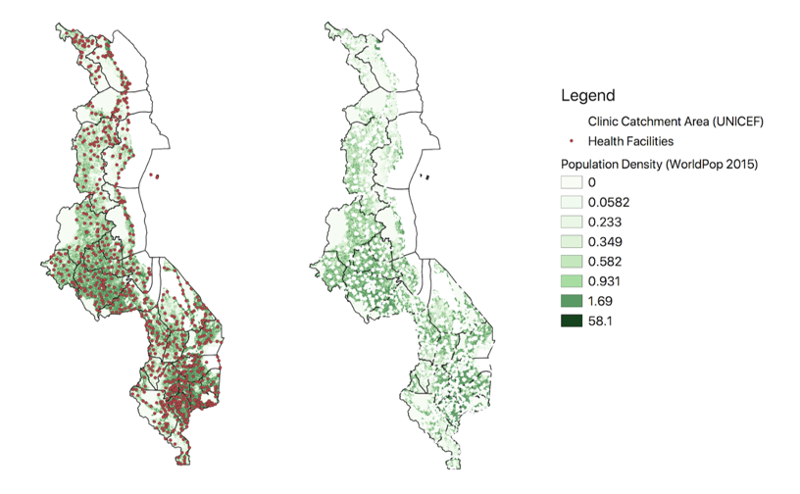
Step 1: Gap in Health Access
7.73 million Malawians, or 44.7%, live more than 5 km walking distance from a clinic
Health Facility locations and catchment areas from UNICEF
Population Density from WorldPop, 2015 estimates
Own calculations of number of people living outside catchment area
Notes:
There are still large gaps in coverage, with 45% of the population (7.7 million) having to walk more than 5 km to access the nearest health facility
Left Map: Orange dots represent every active health facility in Malawi
Right Map: Malawi Population outside of 5km catchment area as calculated by UNICEF, accounting for road network and topography
Calculations made by projecting UNICEF catchment areas onto WorldPop population distribution, and calculating how many people live outside those catchment areas
Top five districts, each with more than 450,000 people without access: Lilongwe, Mangochi, Dowa, Kasungu, Mzimba

Slide 8
Step 2: Validation of Population Projections
Comparing Population Projections Using WorldPop and MNO data to the 2018 census at the district level found less than 5% discrepancy
Notes:
Using linear regression, we extrapolated population levels based on the number of unique users in the MNO data
We compared the population estimates based on this method to those from the 2018 census and found less than 5% discrepancy
WorldPop- Population estimates based on WorldPop alone, projecting forward with homogenous growth rate
Adjusted Using MNO Data- Adjusted district population for population movement patterns based on MNO data
2018 Census- Population levels as reported in the 2018 census

Slide 9
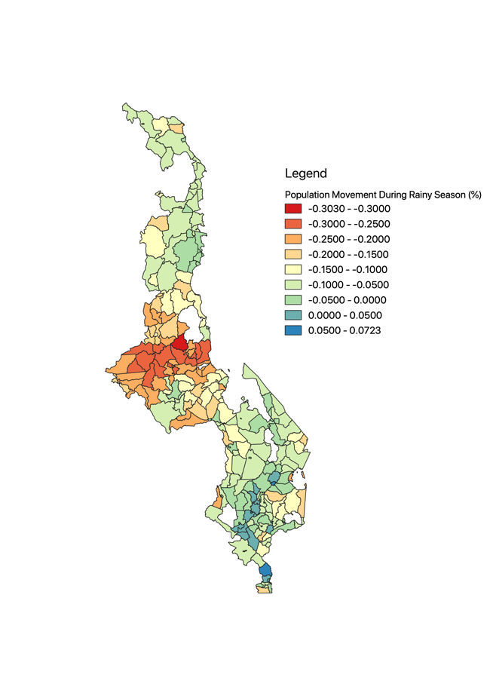
Step 3: Population Growth and Migration Dynamics
Migration During the Rainy Season
Observe seasonal migration during the Rainy Season (November to April):
From the urban agglomeration around Lilongwe
Towards the Shire River Basin
Likely due to agriculture
Shifts in population density between dry and rainy season, benchmarked on change in total unique mobile phone users, from MNO data
Notes:
During the rainy season there is a large-scale migration from the center of Malawi, especially around Lilongwe, towards the South.
In particular, populations shift towards the Shire river basin, an agriculturally fertile land where intensive agriculture is practiced. This offers evidence of seasonal migration, likely driven by the need for labor for agricultural activities.

Slide 10
Step 4: Efficiency of MOH Capital Investment Plan
Efficiency: $\frac{\# of People without Access in District}{\# of New Health Posts}$= People per Health Post
Based on the proposed CIP allocations, the number of people served by each new health posts vary significantly across districts and when accounting for seasonal migration
# of people without access - calculated from catchment areas and population movement patterns from MNO data
# of new health posts – from draft MOH CIP plan
benchmark of 10,000 illustrative, not prescriptive
Notes:
Y-axis: $\frac{\# of People without Access in District}{\# of New Health Posts}$= People per Health Post
Measure of how new health posts are allocated across districts relative to # of people without access. Higher bar mean more people relying on a single new health-post.
Static: Number of people per health post given average levels of population throughout the year
Rainy Season: Number of people per health post allowing for people moving during the rainy season
Dry Season: Number of People per health post allowing for people moving during the dry season
Depending on seasonal migration, the burden on new health posts can vary significantly
Dotted line at 10,000 people per health post is a purely illustrative benchmark

Slide 11
Step 4: Resilience of MOH Capital Investment Plan
Resilience Analysis
Accounting for flooding, using UNICEF’s worst case scenario, certain districts will have up to up to 30,000 people relying on a single new health-post, are much less resilient.
# of people without access - calculated from catchment areas accounting for flooding (UNICEF worst case-flooding scenario), and population movement patterns from MNO data
# of new health posts – from draft MOH CIP plan
Notes:
A Resilience Analysis looks at what happens to burden on health posts if floods occur
If floods occur, certain districts (Blantyre, Nsanje), risk seeing their new health-posts overwhelmed, with up-to 30,000 people relying on a single health-post.
These district are less resilient to a flood-event that could cut-off access to health facilities

Slide 12
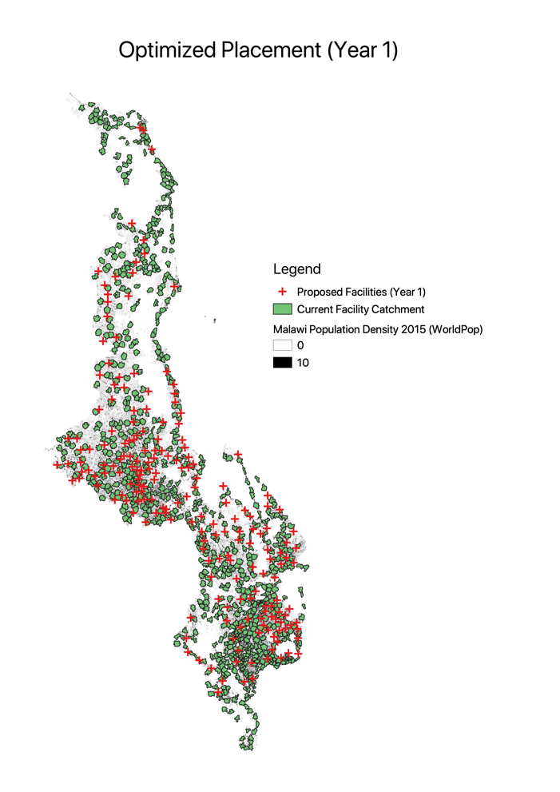

Step 5: Optimizing Allocation of Proposed Facilities
Increased Efficiency in allocation ensures 95% coverage by 2023 with the same resources.
Notes:
Recommendations for years 1 & 2
Based on the gap analysis and population movements, we have sought to allocate new health posts to optimize coverage while ensuring that no health post is over-burdened. Goal is for 95% of population to live within 5km of a health post by 2023
Legend
Green is the catchment areas for existing facilities
Red crosses are the propose facilities, by year
MNO data allows us to predict shifts in population across Malawi
With No new health facilities, 9.7 million people will be uncovered by 2023
Have sought to optimize the placement of new facilities for the CIP
Allocation aims to ensure access to health facilities to 95% of Malawians by 2023
Max number of people per facility is capped at 12,500

Slide 13
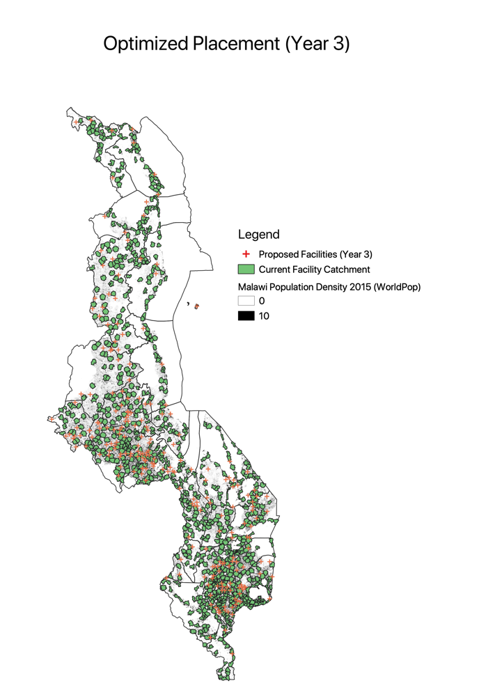

Step 5: Optimizing Allocation of Proposed Facilities
Increased Efficiency in allocation ensures 95% coverage by 2023 with the same resources.
Notes:
Projections for years 3 and 4

Slide 14
Results: Significantly Expands Coverage
Descriptions | Model 1 | Model 2 | Model 3
Year 4 (2023) Forecasted Population | 21,621,892 | 21,621,892 | 21,621,892
Year 4 (2023) Estimated Uncovered population before 900 new health posts | 9,696,818 | 9,696,818 | 9,696,818
Year 4 (2023) Estimated Uncovered % population before 900 new health posts | 44.85% | 44.85% | 44.85%
Year 4 (2023) Estimated Uncovered population after 900 new health posts | 1,122,720 | 1,228,322 | 1,242,047
Year 4 (2023) Estimated Uncovered % population after 900 new health posts | 5.19% | 5.68% | 5.74%
Data Elements Incorporated into the Model | Population Movement (MNO Data) Catchment area | Population Movement (MNO Data), Catchment area, Disease Burden | Population Movement (MNO Data), Catchment area, Disease Burden, Disability Adjusted Life Years
Notes:
Table compares results across all three models, which ranks TAs in terms of priority for a Health Post
Model 1: Accounts for underserved population only based on population movement and catchment area
Model 2: Accounts for underserved population and TA level disease burden but does not rank the severity of disease. w_{j} therefore reflects the total number of patients at the TA level, regardless of disease.
Model 3: Accounts for underserved population, TA level disease burden and the severity of disease, by ranking these according to their severity in terms of disability adjusted life years (DALY). w_{j} therefore reflects the total number of patients at the TA level, weighted by disease.

Slide 15
Results: Increased Efficiency of Allocation
Model re-allocates health posts to maximize coverage
Optimized allocation would provide services to an addition 226,000 people
Notes:
The following proposed re-allocation relative to the CIP tends to emphasize districts with high projected population growth that are currently under-covered
Biggest difference is in Blantyre and Chikwawa. Our model sees large population growth in Blantyre due to urbanization and significant gaps in coverage
Re-allocation also increases resilience, as it favors districts where flooding risks cutting off access to health facilities

Slide 16


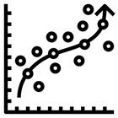

Phase 2: Additional Areas for Exploration
Data as a Public Good for Iterative Decision-Making
Nation-Wide Data User Campaign Providing technical support and training to government counterparts encouraging take-up of analytic tools.
Develop Data Pipeline Work in partnership with private sector (Airtel) and MoH to ensure reliable availability of up-to-date data.
Predictive analytics using AI Forecast health outcomes and food security in response to humanitarian emergencies (Floods, Droughts, Epidemics).
Dissemination & Replication Demonstrate an end-to-end product plugging directly into government systems, with world wide applications in resource constrained settings.
Notes:
In a proposed Phase 2, the emphasis will be on sustainability and use of country systems
Nation-Wide Data User Campaign
Accessing and using the dashboard
Performing routine back-end analytics
Develop Data Pipeline
Negotiate a revised contract with AirTel to secure data transfer every months with the potential to establish a cooperative agreement based on value-added
Work with Ministry of Health (MoH) to ensure availability of health record data
Establish procedure for anonymizing, transferring and uploading the data
Establish protocols for providing access to the data
Predictive Analytics using AI
Incorporating data on disease burden and quality of care
Map population movement in response to flooding and drought
Produce predictive analytics using AI, machine learning algorithms
Dissemination and Replication
seek to replicate this model elsewhere, offering an end-to-end product that can plug directly into existing government systems.
We foresee such a data pipeline combined with a user-friendly dashboard would have world wide application, particularly in resource limited settings where health and population data are scarce but mobile penetration offers an untapped source of insights.

Slide 17

Thank You

Slide 18
Appendix: Technical Approach

Slide 19
Estimating Population Movements through CDR Analysis
Population Movement
Can be utilized to optimize the location of a health post within a given Administrative unit
Can be utilized to factor the net migration factor to be applied on the static yearly population forecast of a given Administrative Unit
Short Term Movement
Long Term Movement
Dynamic Population Movement
Seasonal Migration
Permanent Migration
Intra-day and within a week, or event based
3-6 months movement, say between 2 regions with a year
More than 6 month of movement

Slide 20
Foundational Approach - High Level Overview
Prepare Reference Population Density Forecast
Model Call density to Population density relationship
Model Population Movements from CDR data
Interpolate/Extrapolate the Population Density (2016-2023) at TA Adm Unit level using Exponential/Alternate Growth model
(Worldpop 2015 & 2020 population density data)
Model a Power Law relationship between CDR Call Density and Population Density in an Adm Unit (2016-2018 Airtel CDR data)
Analyze the CDR to model
Short term movements
long term movements
Estimate Migration Factor using long term movement
Estimate Points of Interest using short term movement
Model Mobility Growth & Forecast Migration Factor
From long term population movement (migration) model, extract the inflow/outflow factor for each Adm Unit
Apply Call to Population density scaling factor to get the adjusted population
(2016-2018 Airtel CDR data)
For each Adm Units, estimate points of interest with high transient intra-day population
For each Adm Unit, identify temporal shifts if any of points of interest
(2016-2018 Airtel CDR data)
Using 2016-2017 mobile growth rate, model an empirical (exponential) mobile user base growth, and extrapolate the migration factor for 2019-2023.
Optimization Model

Slide 21
Population Density Mapping using Anonymized CDR - Approach
For scaling the population movements analyzed through Mobile CDR as a proxy, we need to establish a relationship between the mobile user density to the population density. This is done through two steps approach.
Step1- Compute MP (mobile phone) User Density for each Administrative Unit
Step 2.a- Magnify MP User Density against Census / RS derived population density using Power Law
Step 2.b- Cross validation procedures to derive “α ” and “β” parameters
Step 2.c- Sensitivity analysis of “α ” and “β” parameters
Notes:
Population Density Mapping using Anonymized CDR is two steps approach.
Step1- Compute MP (mobile phone) User Density for each Administrative Unit
Step 2 (This step is further broken down into three sub-steps)
----------------------------------------------------------------------------
Step 2.a- Magnify MP User Density against Census / RS derived population density using Power Law
Step 2.b- Cross validation procedures to derive “α ” and “β” parameters
Step 2.c- Sensitivity analysis of “α ” and “β” parameters

Slide 22
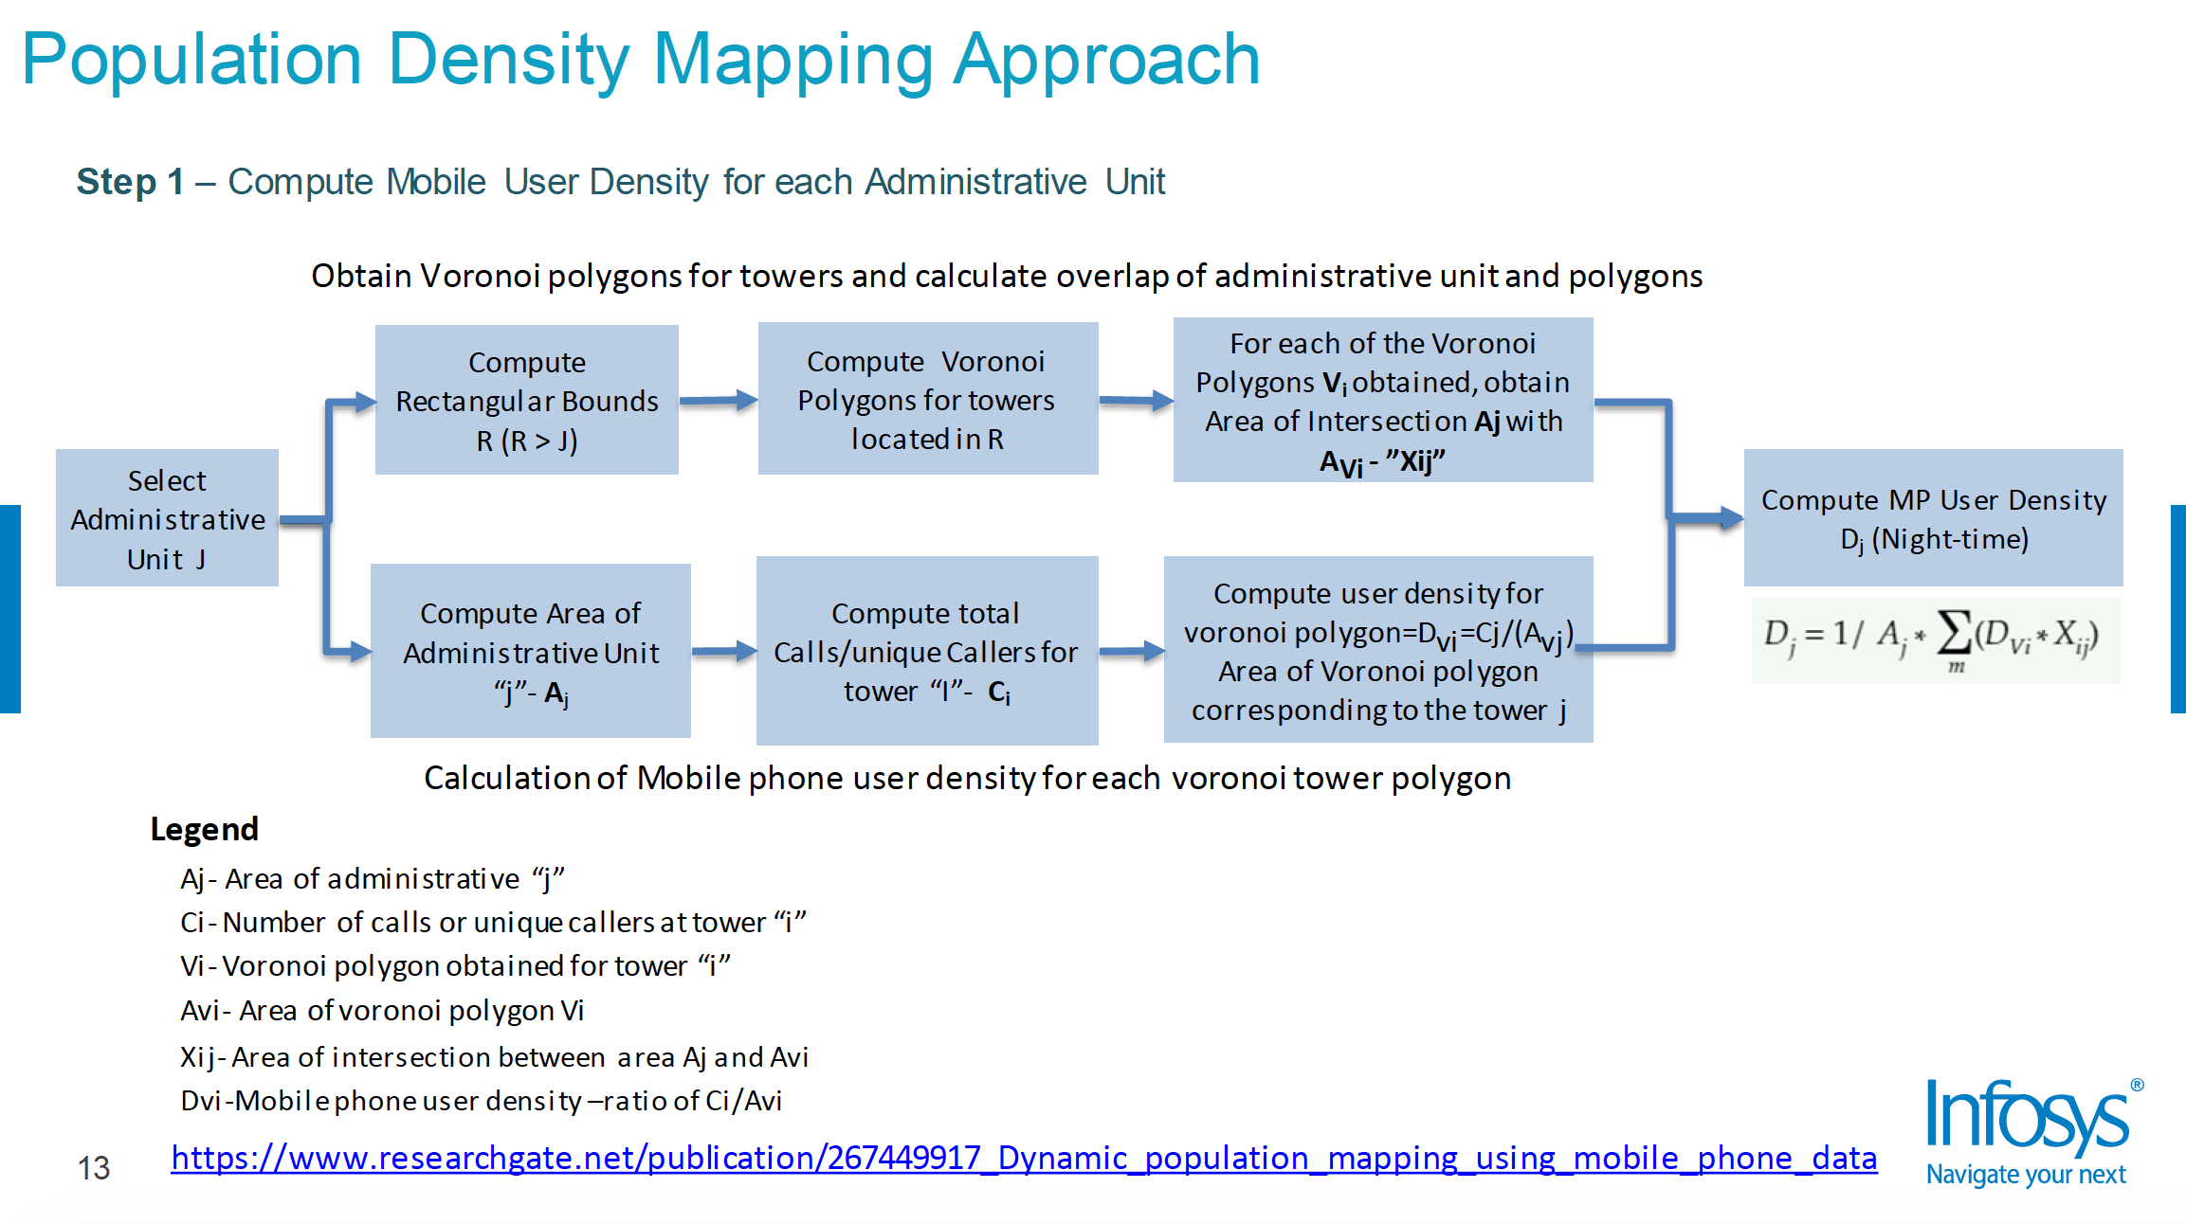
Appendix: Technical Material

Slide 23
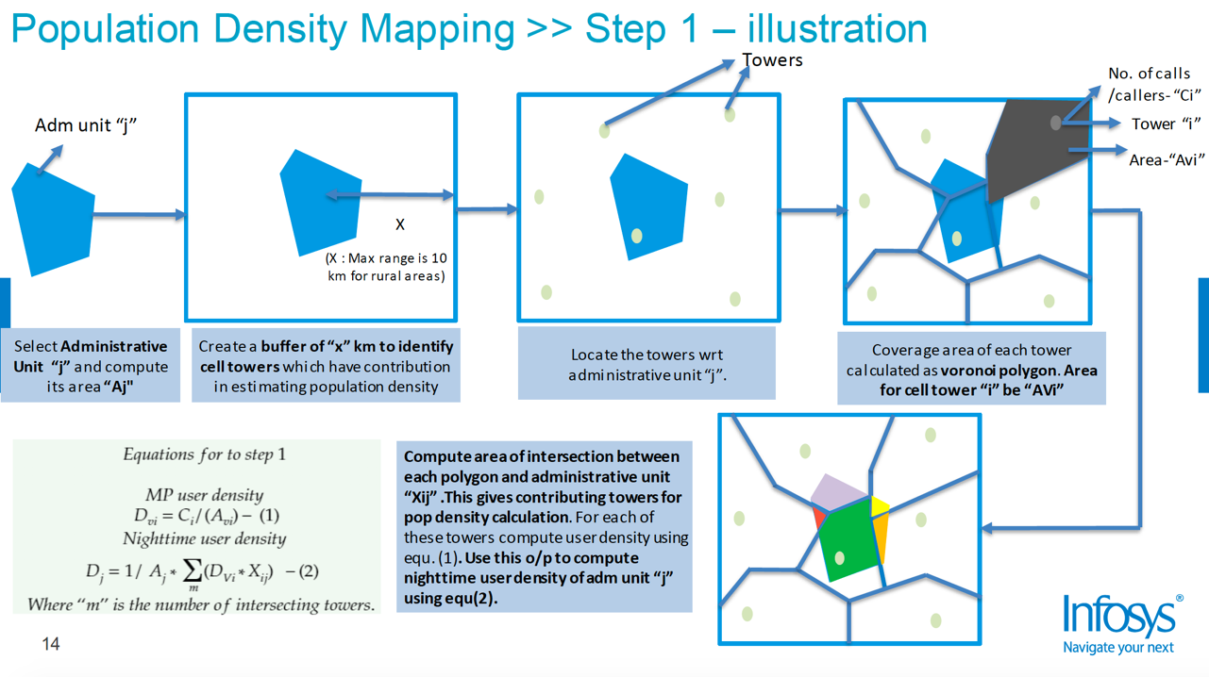
Appendix: Technical Material

Slide 24
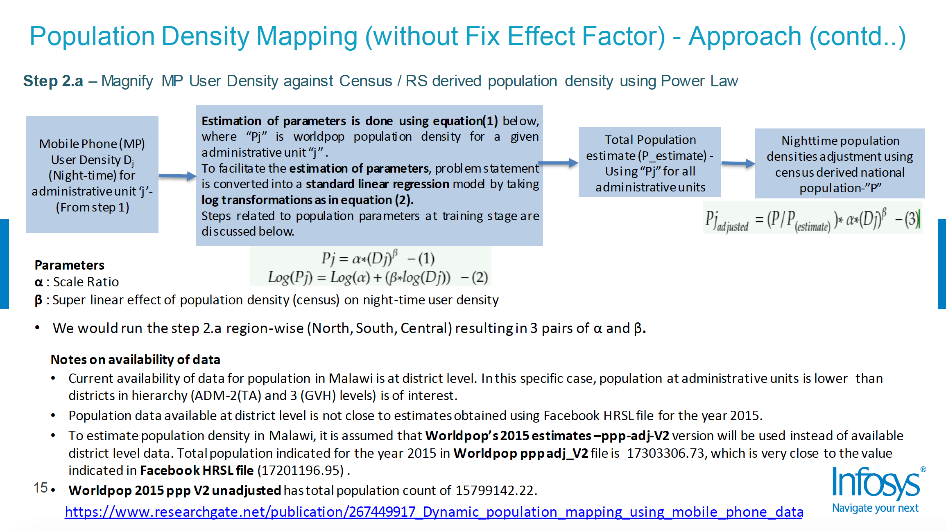
Appendix: Technical Material

Slide 25
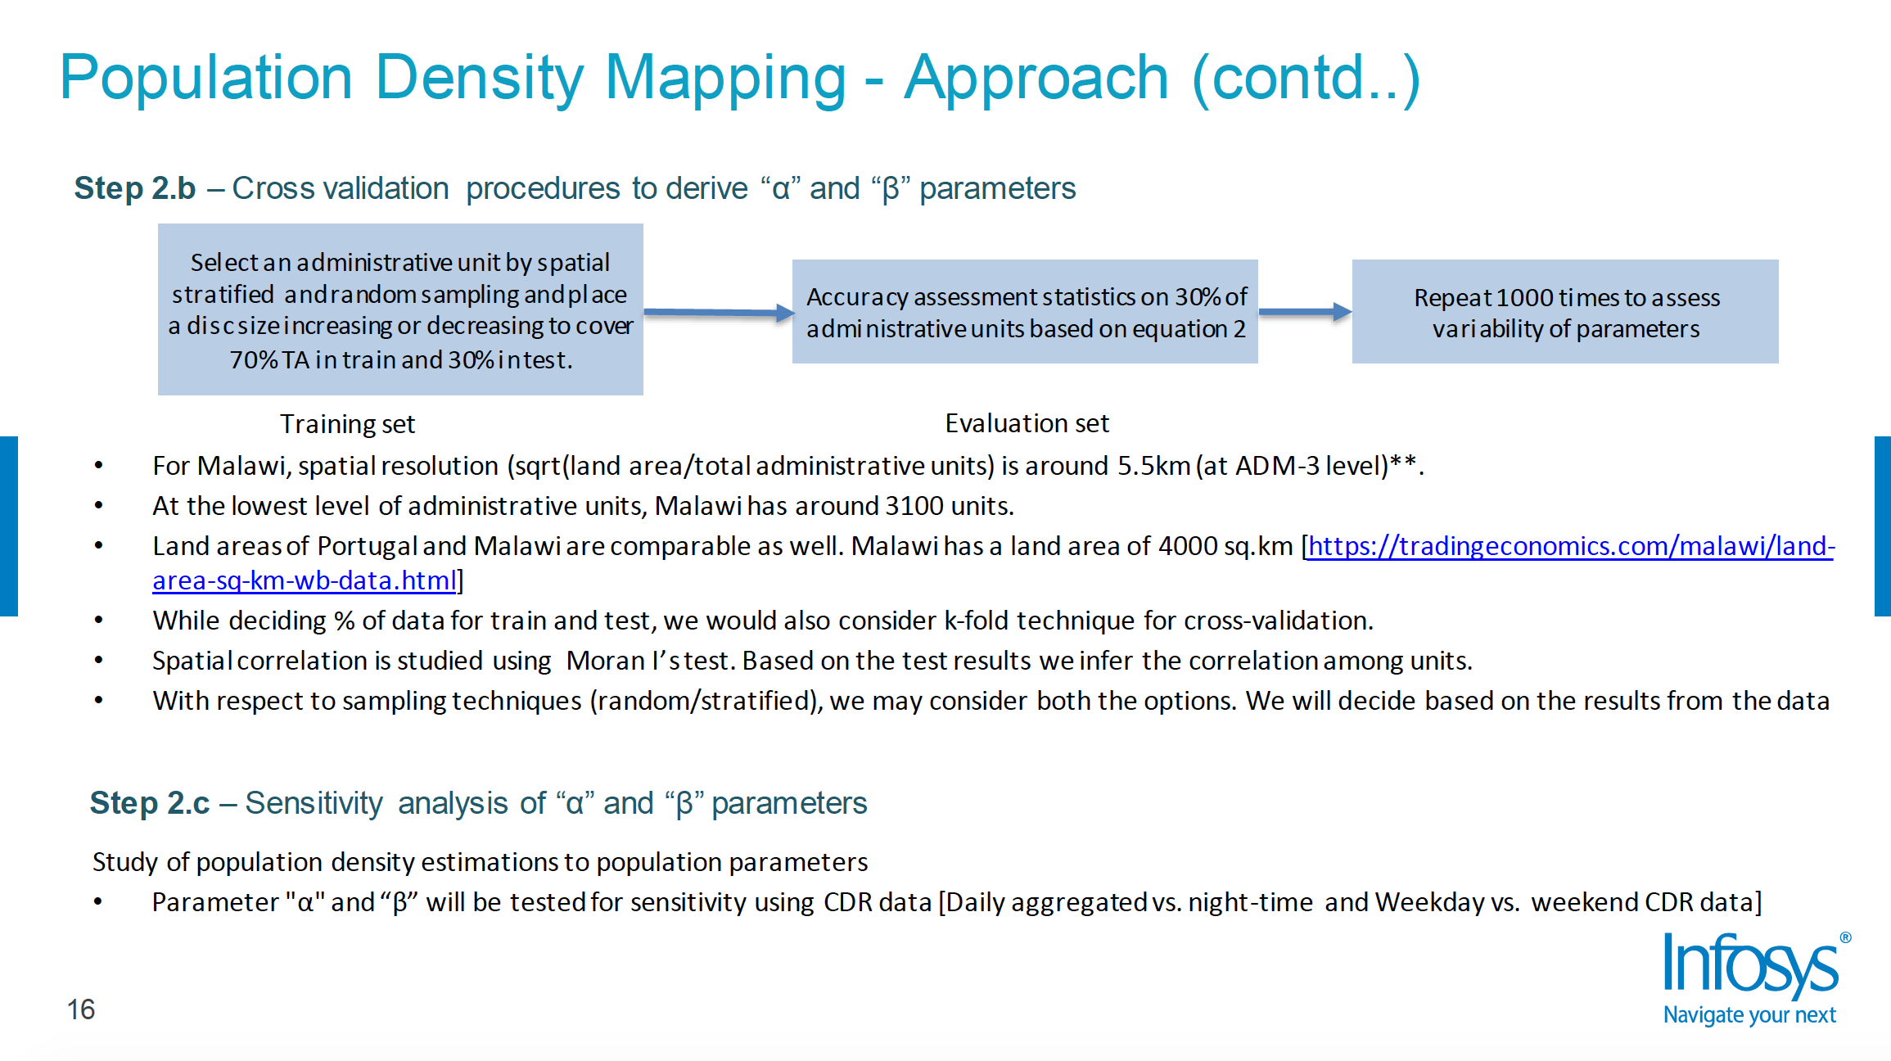

Slide 26
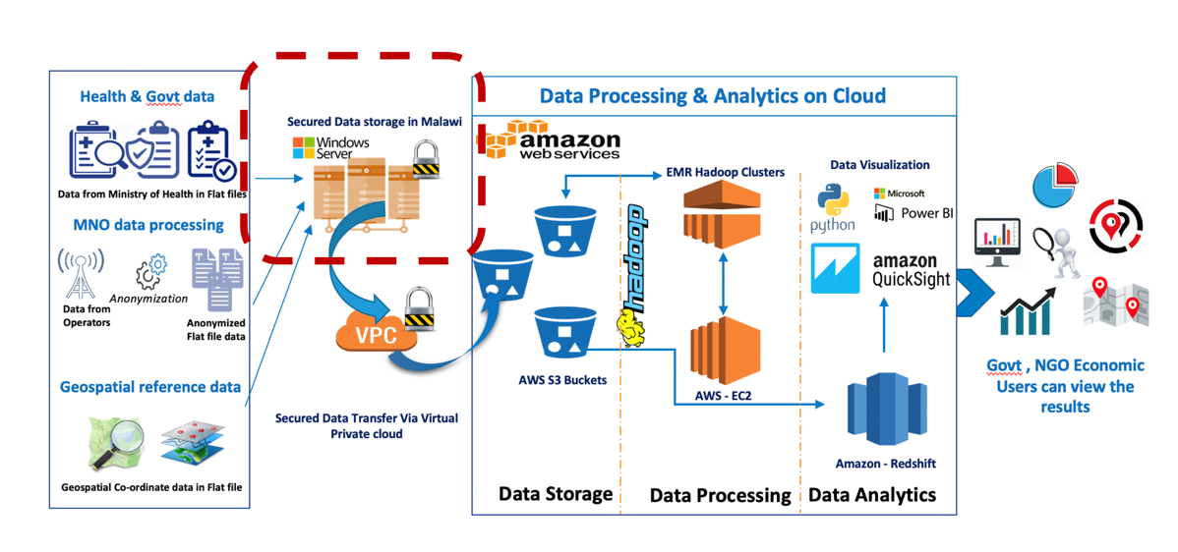
Data Pipeline and Analytical Platform
Notes:
The ‘backbone’ of the analytic platform, with data housed in country as per national requirements and analysis performed on the cloud.
Insights are pushed to stakeholders in the Ministry of Health as reports and dashboards.

